Slide 1
Storm architecture

Slide 2
Storm
Open source distributed Real-time computation system
Developed by Nathan Marz
Acquired by Twitter
Used extensively in Twitter and Yahoo!

Slide 3
Storm Features
Integration
Integrates with any queuing system and any database system
Salable
Inherently parallel and runs across a cluster of machines
High throughputs of messages with very low latency
Benchmarked processing one million 100 byte messages per second per node on the following hardware
Processor: 2 x Intel E5645@2.4 Ghz
RAM:24GB
Use with any programming language
Ruby, Python, Java, Javascript, Perl, PHP

Slide 4
Storm Features
Fault tolerant
When a node dies, the worker will be restarted on another node.
Storm daemons are designed to be stateless
Guarantees data processing
Guarantees every tuple will be fully processed.
Tracks lineage of a tuple as it makes its way through the topology.
Provides an at-least-once processing guarantee
The same guarantee from a queuing system
Messages are only replayed when there are failures.
When a consumer of a tuple dies then a new consumer that takes over may get some duplicate tuples
For example if the application is doing word count. Then this would mean a higher than actual resultant count.
Guaranteeing exactly once processing is much more expensive than at-least-once
Need to use two phased commit.
Better write applications so they can tolerate occasional duplicates.
Storm offers Trident which is higher level abstraction (like Pig or Hive) on top of Storm
Can guarantee exactly once processing.

Slide 5
Storm Abstractions
Tuples
Spouts
Bolts
Topologies

Slide 6
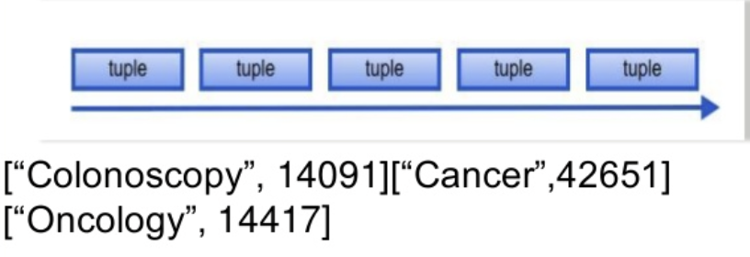
Unbounded Sequence of Tuples
In storm you manipulate and transform streams of tuples.
Tuples are a named list of values
Tuples can contain objects of any type
If you want to use a new type you will need to write a serializer.

Slide 7

Spouts
A source of streams in a computation
Can read from the following sources
A queuing broker such as Kestrel, RabbitMQ, Kafka
Web logs
Databases
Twitter streaming API
Generate its own stream
Etc.

Slide 8

Bolt
Processes any number of input streams and produces any number of output streams
Most of the logic of a computation goes into bolts
E.g. Filters, Streaming Joins, Streaming Aggregation, Talking to Databases, etc.

Slide 9
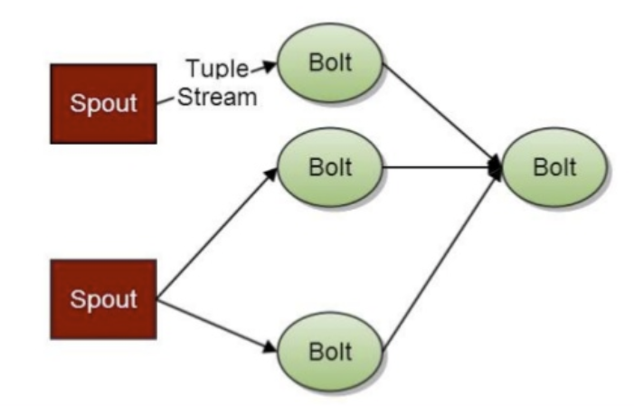
Topology
Network of spouts and bolts, with each edge in the network representing a bolt subscribing to the output stream of some other spout or bolt.
A topology is an arbitrarily complex multi-stage stream computation that runs indefinitely when deployed.

Slide 10
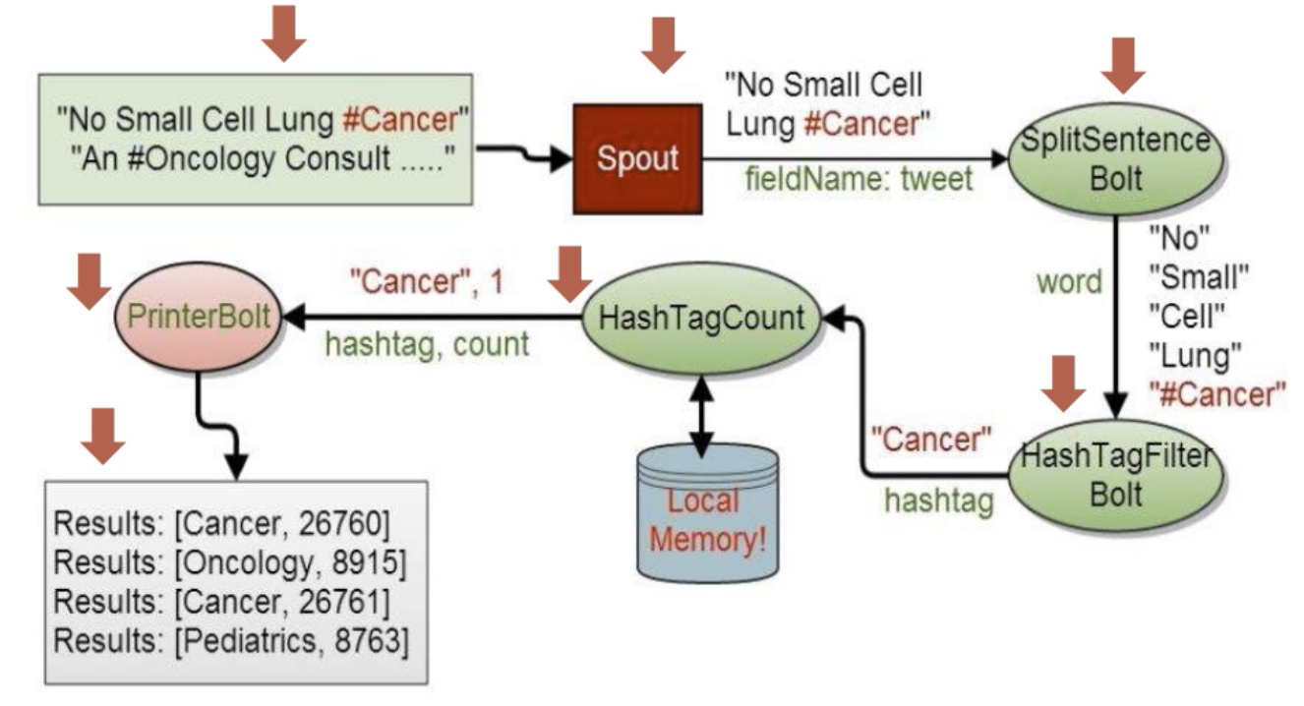
Topology Example
Suppose we want to count the number of times every #tag has appeared in a stream of twitter feeds
The above example shows how this can be done in storm.

Slide 11
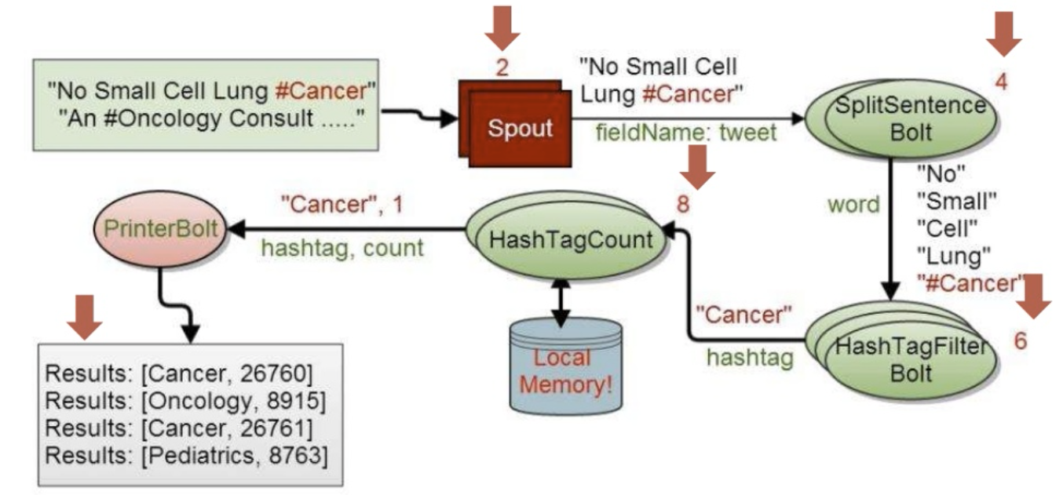
What about Parallel Processing?
The programmers specify the number of parallel tasks for each spout and bolt.

